Slide 1
DATA ANALYTICS ICC T20 WORLD CUP 2021

Slide 2
The Team
IBM Mentor
MR. Parbhu Bhaskar
Edunet Mentor
MR. Deepnel Majumdar
Student Team
Team – 06
NSTI BENGALURU

Slide 3
Workload Division
Contribution of each team member in project
Sudhanshu – Documentation , Data Collection, Exploratory Data Analysis and Visualization.
Amit - Data Collection and Visualization.

Slide 4
The Background
On 17 February 2005 Australia defeated New Zealand in the first men's full international Twenty20 match, played at Eden Park in Auckland. The game was played in a light-hearted manner – both sides turned out in kit similar to that worn in the 1980s, the New Zealand team's a direct copy of that worn by the Beige Bridge. Some of the players also sported moustaches/beards and hair styles popular in the 1980s taking part in a competition amongst themselves for best retro look, at the request of the Beige Brigade. Australia won the game comprehensively, and as the result became obvious towards the end of the NZ innings, the players and umpires took things less seriously – Glenn McGrath jokingly replayed the Trevor Chappell underarm incident from a 1981 ODI between the two sides, and Billy Bowden showed him a mock red cards (red cards are not normally used in cricket) in response.

Slide 5
Problem Statement
India and so many nations that were playing cricket and as they are improving themselves day by day or per matches. From this Data Analysis we can get the all data of players regarding their performances.
Ideally, we also have to know about the data and performance of players and nation also. By this one player can improve their performances. It’s also help in getting prepared for a specific player.

Slide 6
Proposed Solution
As well as helping you to solve batting related issues, research problems (and associated questions) help you to think critically about issues .
Once our research team have a few observations, prioritize them based on their batting performance. It may be that you can answer more than one question with a single study, but don’t do it at the risk of losing focus on your overarching research problem.
We research that scoring areas of batsmen's and their dismissals . We have validated the information after collection of data and analysis.
We solved out where to batsmen improve themselves against the bowlers that he had faced during the tournament.

Slide 7
Solution Design
Steps for data collection,pre-processing and visualization.
Raw Data From ICC Sites
Processed Data in Structured form
Modelling of feature set
Data Visualization

Slide 8
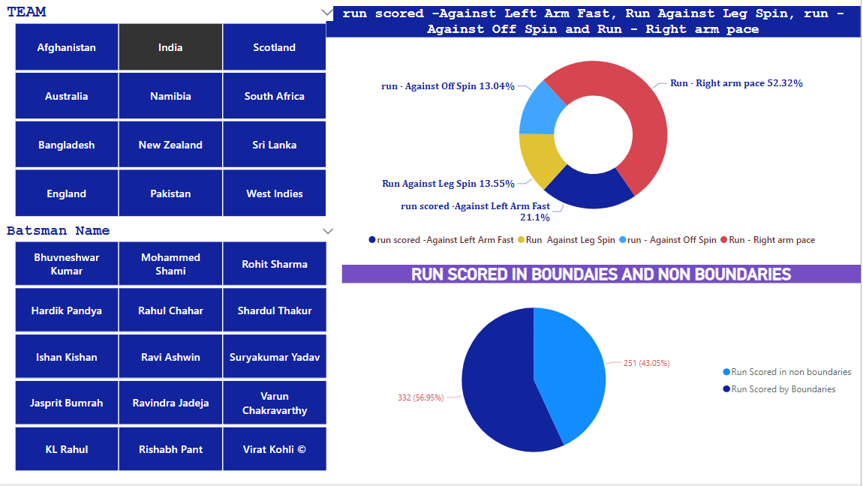
To know whether there is any difference in scoring runs against Right/Left arm pace and Off/Leg Spin. This can be achieved by a donut chart as given below:

Slide 9
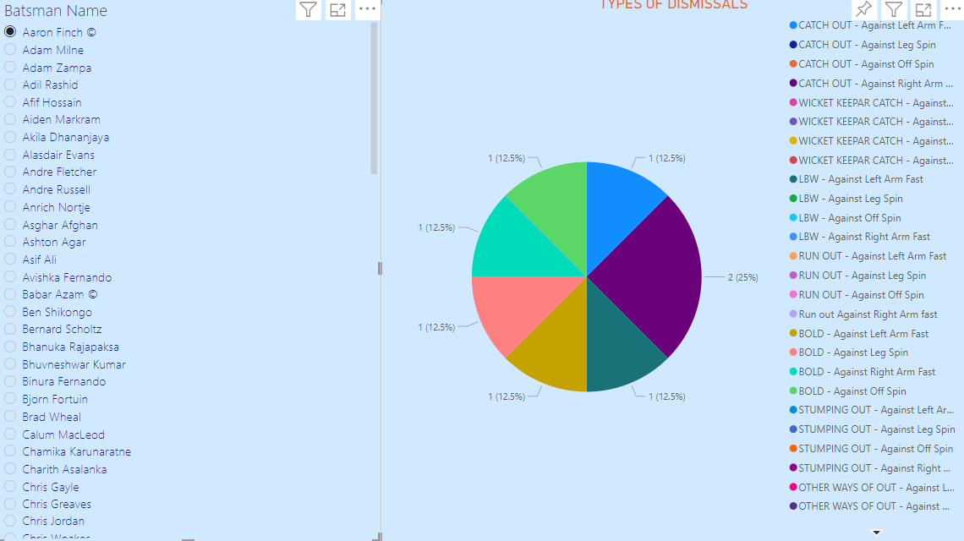

Slide 10
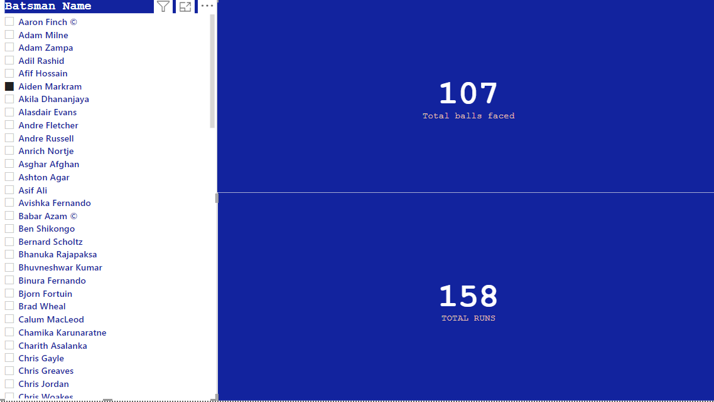

Slide 11
Technology Stack & Requirements
The process of data analysis uses analytical and logical reasoning to gain information from the data. The main purpose of data analysis is to find meaning in data so that the derived knowledge can be used to make informed decisions .
System Requirements
Operating system, Minimum CPU or processor speed, Minimum GPU ,RAM.
Software Requirements
Excel , Power BI , Git Hub
A Hybrid Cloud environment is used to deploy private cloud for critical workloads and a public cloud to host less critical workloads

Slide 12
Innovative Idea
The general problem-solving model can be described as involving the following steps:
To improve batsmen performance to increase more opportunities to win matches. To make them more batter then other batsmen’s.
We collected all the data regarding their performances through out the tournament. Where they faced difficulties and their good point of stats.
We can diagnose the problem by seeing their data/stats through out the tournament. We can solve out this only by doing more practices on weak point.
We develop most precious solutions regarding their issues which are visualise using Donut chart, pie chart and cards also.
We analyse each possible solution that we think it must be required and helpful. To improve their stats in their carrier to make more runs and less dismissals.
If they implement this data analyse in their performance it will improve their strike rate as well as their scoring ability. We can also evaluate this one lets take a i.e. if we applied it on Virat Kohli he can also score runs by making boundaries against spinners as well as scoring by one/twos it will provide Kohli scoring abilities in upcoming tournaments.

Slide 13
Results/Outcomes/Analysis
RESULT :-
The data consists of 182 batsmen. Though we can see the data related which one scored most runs i.e. Babar Aazam from Pakistan scored most runs .
Through this batsmen also find that in which point/way they have to play against the bowlers so they can score maximum runs.
The most popular is where to they work so they can hit a maximum numbers of boundaries .
All batsmen also need to improve their strike rates.
Solution Developed :-
In this we have develop performances of players regarding their stats against bowlers and their dismissals also.
We also developed their heating/scoring abilities in powerplay, middle & death overs.
We also developed solution regarding where to they have to improve to score more runs.

Slide 14
Limitations
The present paper is the first study to link the performances of players and their development against bowlers by applying quantitative and statistical analysis using ICC T20Wrld Cup 2021 Data .
It is found that some players are unable to improve themselves in specific areas.
There is a lot of pressures on players regarding to their performance because they are representing their nation and they had to won cup for their nation.

Slide 15
Future Enhancements/Scope
In future we want to do predictive analytics using Artificial Intelligence and Machine Learning. So we can implement the need of the players, what they want we can full fill their needs and take the feedback for all the team which can help to improve their performance .
We also want to do predictive analytics regarding the upcoming ICC Men T20 World Cup 2022 which will be held in Australia. Which team will won the upcoming World Cup and the main reason behind our predictive analytics.

Slide 16
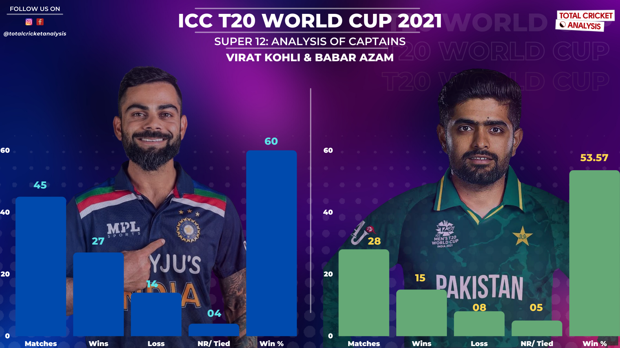

Slide 17
Thank You

